Slide 1
Intel x86 Architecture PMC
Mina Neronde
Electrical and Computer Engineering Department
University of California, Davis
mneronde@ucdavis.edu

Slide 2
1. Download The Manual
Intel 64 and IA-32 Architectures Software Developer’s Maunal
- Link: https://software.intel.com/en-us/articles/intel-sdm
Environment: Intel x86 architecture 3rd generation called Ivy Bridge
- Ivy Bridge uses the same description with Sandy Bridge in the manual
- command ‘lscpu’ in the terminal of Linux provides the information of the processor

Slide 3
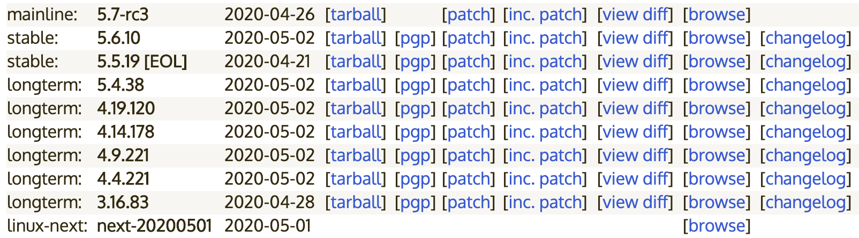
2. Prepare Linux Environment
The Lab Computer (Host PC) has installed with Ubuntu 18.04.4 distro
Ubuntu 18.04.4 kernel version: Linux Kernel v.5.3
Download Linux kernel code: https://www.kernel.org/
- Important: download the kernel code version matching or lower than the host PC kernel version
- e.g. For Linux kernel v.5.3 of the host pc, downloaded 4.19.120 (Above 5.3 version doesn’t work)
- after downloading in any directory in Linux, upzip the file by using the command ‘tar –xvf filename’

Slide 4
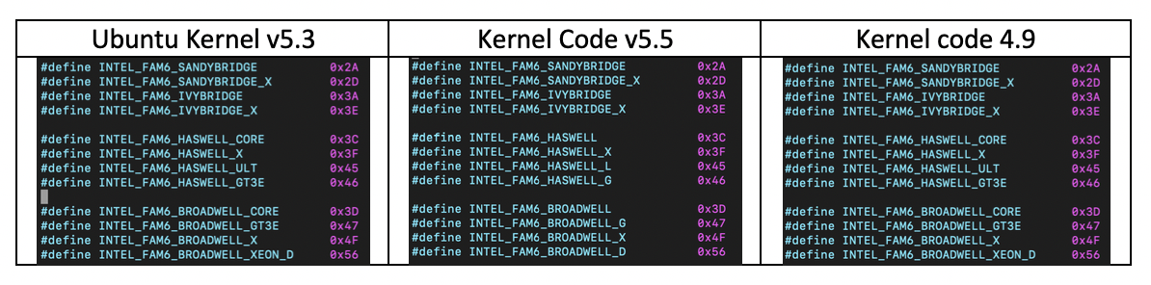
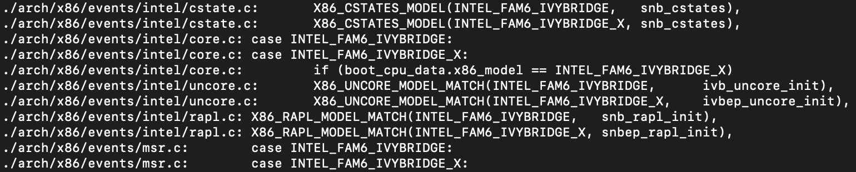
2. Prepare Linux Environment (Cont)
Why installing kernel code from kernel.org with the version that is lower or same?
- Versions above have different code (Table 1)
- When use command ‘grep,’ some results are not shown in the host kernel so that use grep to do a specific search in downloaded kernel code.
<Table 1: Different code depending on the kernel version>

Slide 5
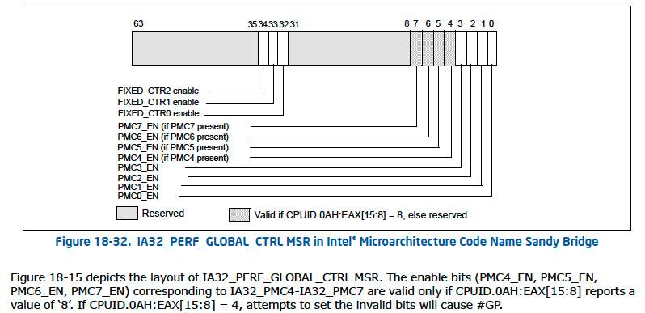
3. Check How Many Performance Counters Available
According to the Manual (p.692), Sandy bridge has 8 performance counters available
- On the bottom contents of register figure, it says CPUID.0AH:EAX[15:8] reports a value of ‘8’, PMC4 – PMC7 are valid
PMC0 – PMC3 are absolutely available, and details about PMC5 – PMC7 (if PMC present) is followed by the next slide

Slide 6
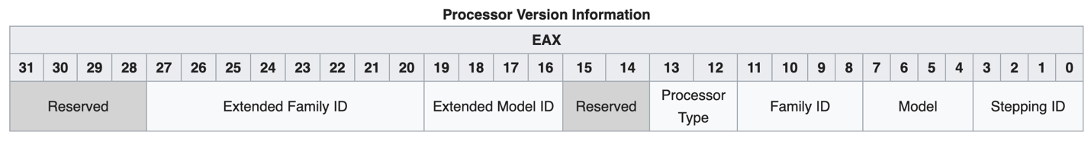
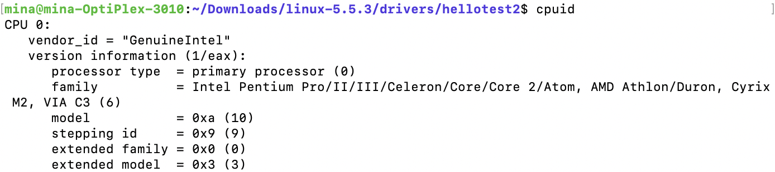
3. Check How Many Performance Counters Available (Cont)
To find whether PMC5 – PMC7 are available, check CPUID.0AH:EAX[15:8] reports 8, which are composed of 2 bits of Reserved, 2 bits of Processor Type, and 4 bits of Family ID
In the terminal of Linux, type cpuid to see the information about EAX[15:8]
- if the command is not installed, install it first
- command: sudo apt-get install cpuid

Slide 7
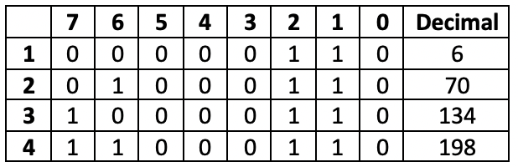
3. Check How Many Performance Counters Available (Cont)
Family ID, which is EAX[11:8], is 6 according to the command ‘cupid’
Processor Type, which is EAX[13:12], is 0
Reserved, which is EAX[15:14], can be 4 cases
- Reserved can be 0,1,2,3 (bit [7:6] in the Table 2)
None of the cases could be 8 so that when running the PMCs, 8 of PMCs report the counts accordingly
Some of Ivy Bridge processor was able to read 8 PMCs
It could be sorely applicable to Sandy Bridge, Manual doesn’t have section only for IvyBridge
<Table 2: Different code depending on the kernel version>

Slide 8
4. Source Code
Source code is based on this manual: Intel 64 and IA-32 Architectures Software Developer’s Manual, Volume3 (3A, 3B, 3C & 3D): System Programming Guide
Source code has been attached with this instruction document
For Sandy Bridge processor, addresses of registers starts from p.1435

Slide 9
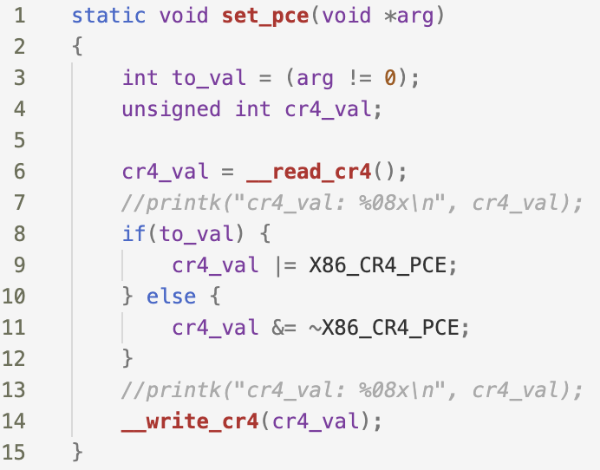
4. Source Code (Cont)
Control Register 4 (Manual p.79)
Bit 8 of CR4 (Control Register 4) needs to be set to use RDPMC instructions
Two system calls we can use:
__read_cr4()
__write_cr4(value)
Read cr4 to keep other bits same as before (we need change only bit 8)
Use a bit-wise operation to change bit 8 of the value obtained from __read_cr4(), Write the value back to the register

Slide 10
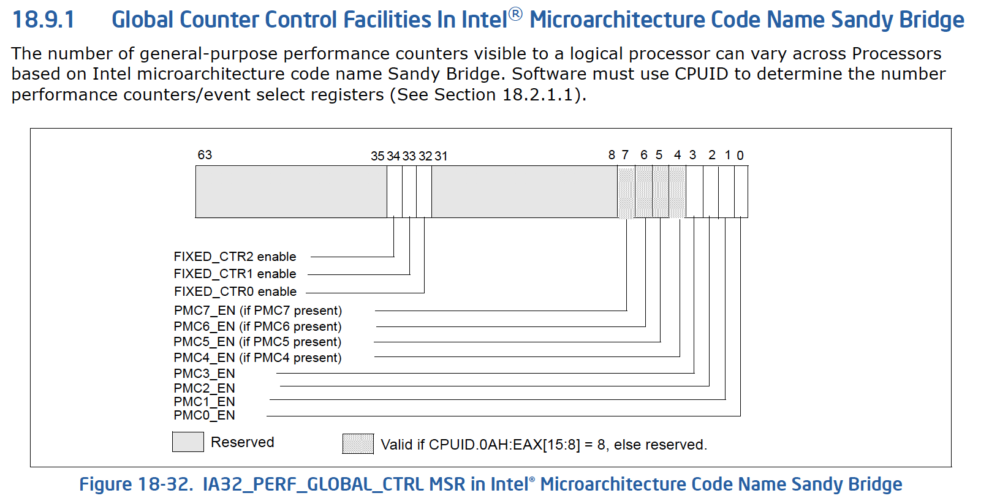
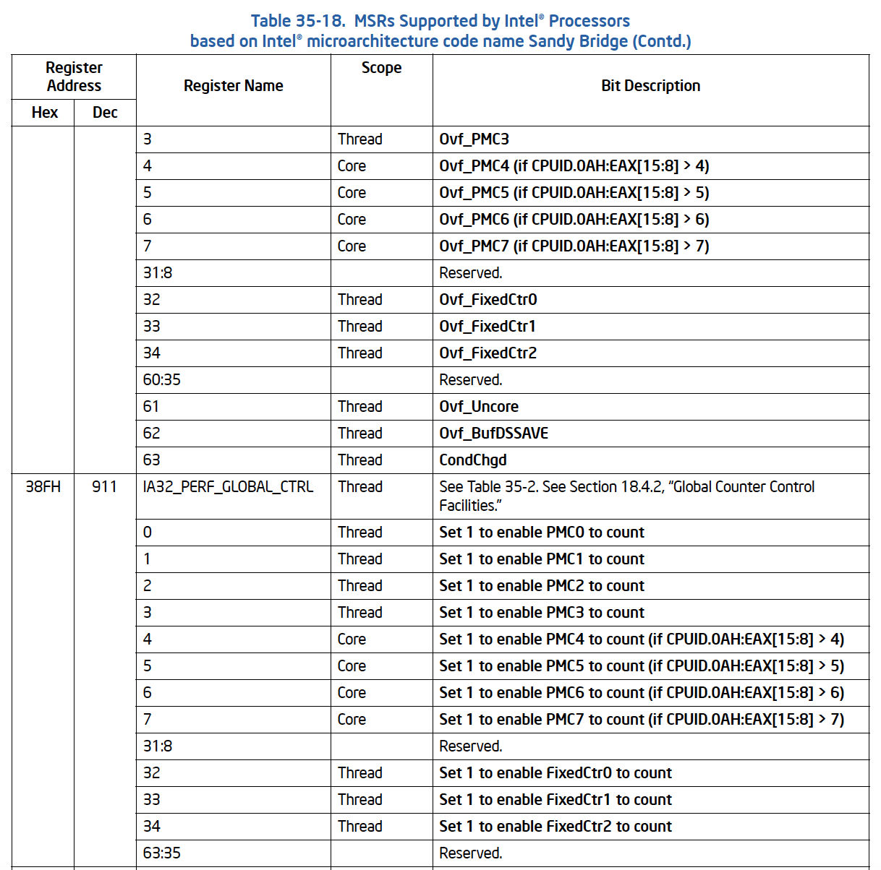
4. Source Code (Cont)
2) Global Control Register (Manual p.692)
To use PMCs, we need to modify PERF_GLOBAL_CTRL MSR
[n:0] bits are PMC enable bits
* N is dependent on available PMCs
Method to check how many PMCs is in chapter 3 (5th slide)
Perf_GLOBAL_CTRL MSR address is presented in p.1445
Its address is 0x38F

Slide 11
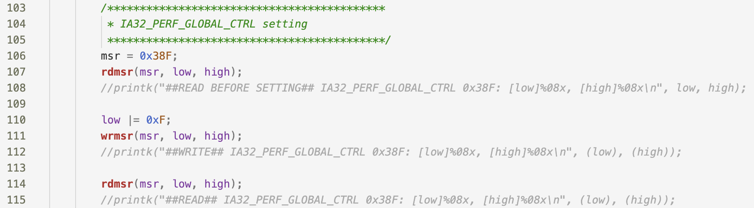
4. Source Code (Cont)
2) Global Control Register (Cont)
To keep the original value, read MSR value in the address 0x38F
Depending on the number of PMCs, 0xFF (in case of 8 PMCs) or 0xF (in case of 4 PMCs) is applied to the value from previous step
Double check the value is set by reading the register again

Slide 12
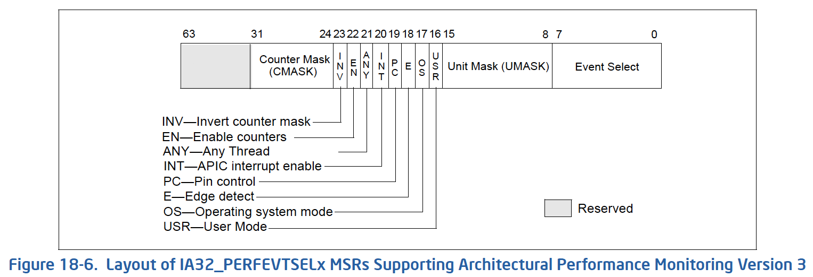
4. Source Code (Cont)
3) Event Register (Manual p.650)
We need to set bit[23:16] to 0x43, which enables EN, OS, and USR bits, according to the Intel official document (Not the manual)
No need to change bits other than bit 22 and bit[15:0]
Unit Mask (UMASK) and Event Select [15:0]: Possible events are followed in the next slide

Slide 13
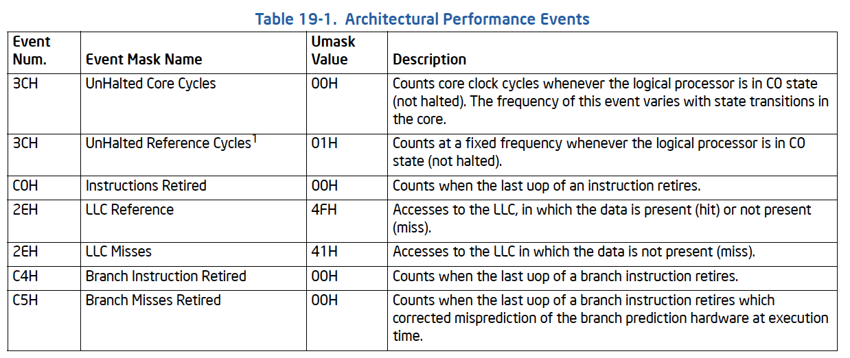
4. Source Code (Cont)
3) Event Register (Cont, Manual p.764)
This table shows the value of Event Select bits and UMASK bits
These values are already defined in the kernel, explanation is followed by the next slide

Slide 14
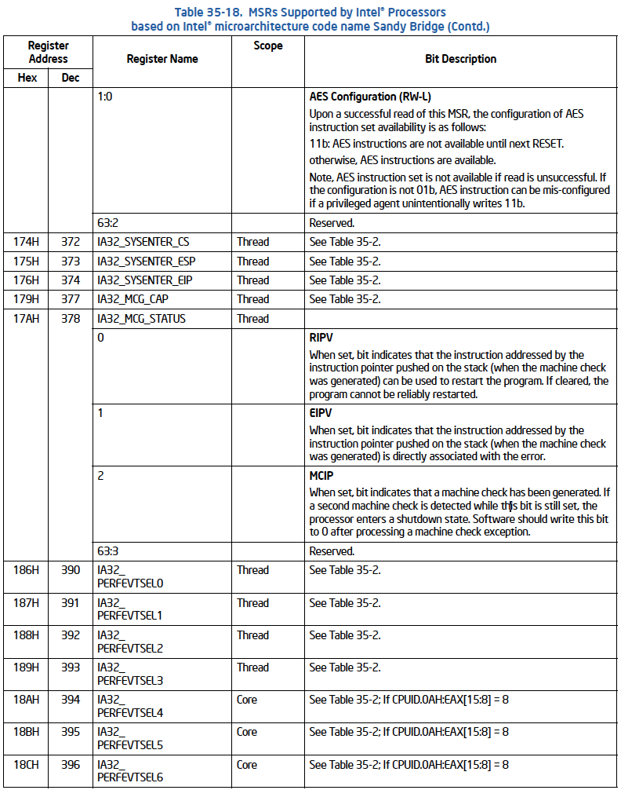
4. Source Code (Cont)
[EVENTS]
[PERF_COUNT_HW_CPU_CYCLES] = 0x003c,
[PERF_COUNT_HW_INSTRUCTIONS] = 0x00c0,
[PERF_COUNT_HW_CACHE_REFERENCES] = 0x4f2e,
[PERF_COUNT_HW_CACHE_MISSES] = 0x412e,
[PERF_COUNT_HW_BRANCH_INSTRUCTIONS] = 0x00c4,
[PERF_COUNT_HW_BRANCH_MISSES] = 0x00c5,
[PERF_COUNT_HW_BUS_CYCLES] = 0x013c,
[PERF_COUNT_HW_REF_CPU_CYCLES] = 0x0300, /* pseudo-encoding */
3) Event Register (Cont, Manual p.1438)
These events are used and found in the Perf tool
This is found in this directory: ~/Linux-4.19.120/arch/x86/event/intel/event/core.c
* command [grep –r ’HW_CPU_CYCLES’ ./* ] in downloaded kernel folder (In my case, Linux-4.19.120 folder)
the addresses for PERFEVTSEL registers are presented in the manual (image on the right)

Slide 15
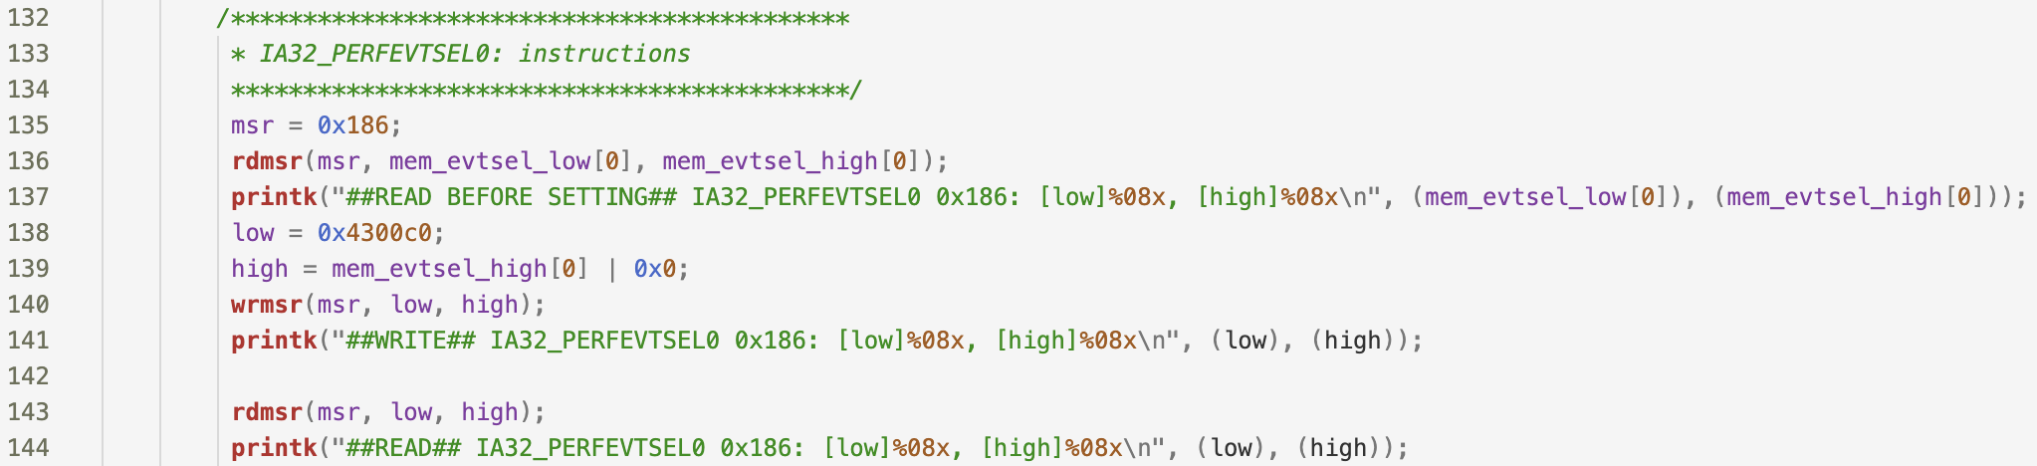
4. Source Code (Cont)
3) Event Register (Cont)
Checking PERFEVTSEL register by using system call rdmsr to the address 0x186
Select an event from the previous slide and add the event value to the bit[23:16] (= 0x43), which enables EN, OS, and USR bits, resulting in 0x4300c0 in line 138 of the code
Double check the value 0x4300c0 is written into the register by reading it again

Slide 16
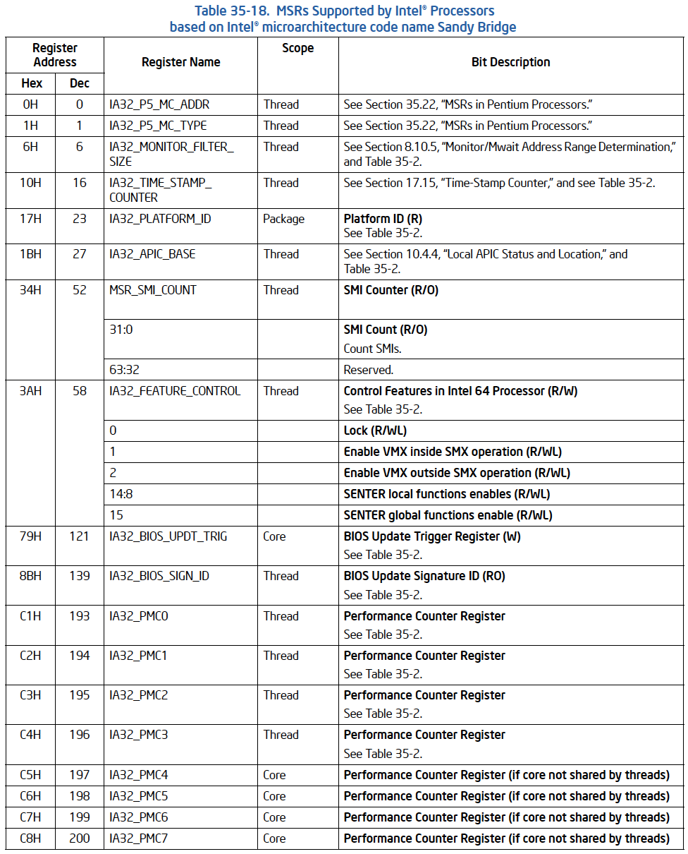
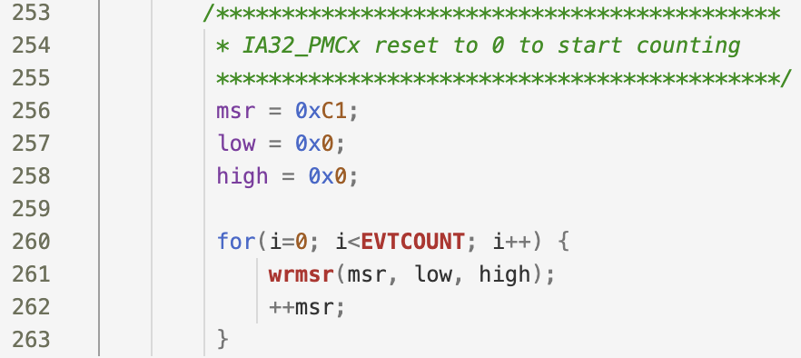
4. Source Code (Cont)
4) PMCs (Manual p.1435)
The address for PMCs starts from 0xC1
Before reading these PMCs, reset the counters to 0
After reset, place a program so that the PMCs count the occurrence of each event that is assigned in the previous step

Slide 17
4. Source Code (Cont)
4) PMCs (Manual p.1435)
The address for PMCs starts from 0xC1
Before reading these PMCs, reset the counters to 0
After reset, place a program so that the PMCs count the occurrence of each event that is assigned in the previous step

Slide 18
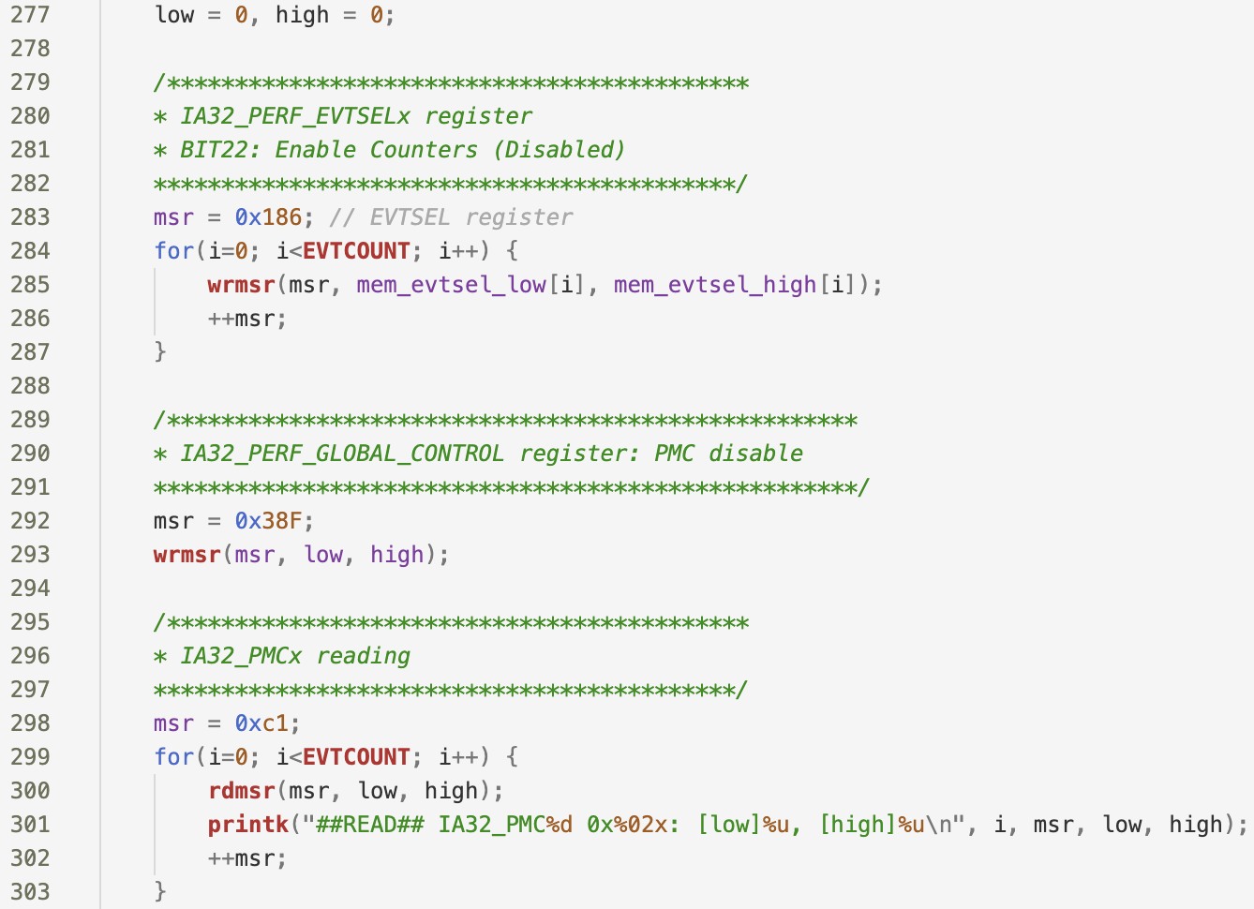
4. Source Code (Cont)
5) PMCs (Stop counting)
By disabling either PERF_EVTSELx registers or PERF_GLOBAL_CTRL register, PMCs stop counting
Mem_evtsel_low and mem_evtsel_high have the value before a user changes the value of the register; this prevents the kernel from panic by conserving the other bits except the bits we plan to change
From slide 11, when printing in the kernel before changing the value, PERF_GLOBAL_CTRL register reports 0. This register manages enable/disable of other registers, so that writing 0 back seems to be safe
Do not extract this part in a separate function because PMCs keeps counting until the EVTSELx and GLOBAL_CTRL registers are disabled

Slide 19
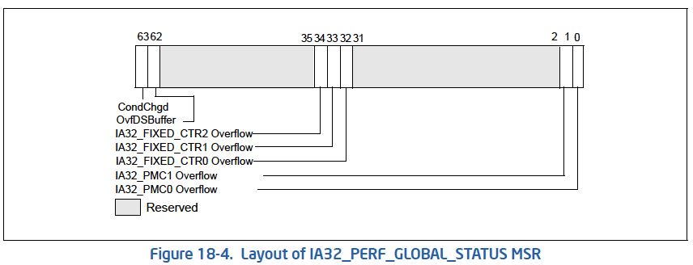
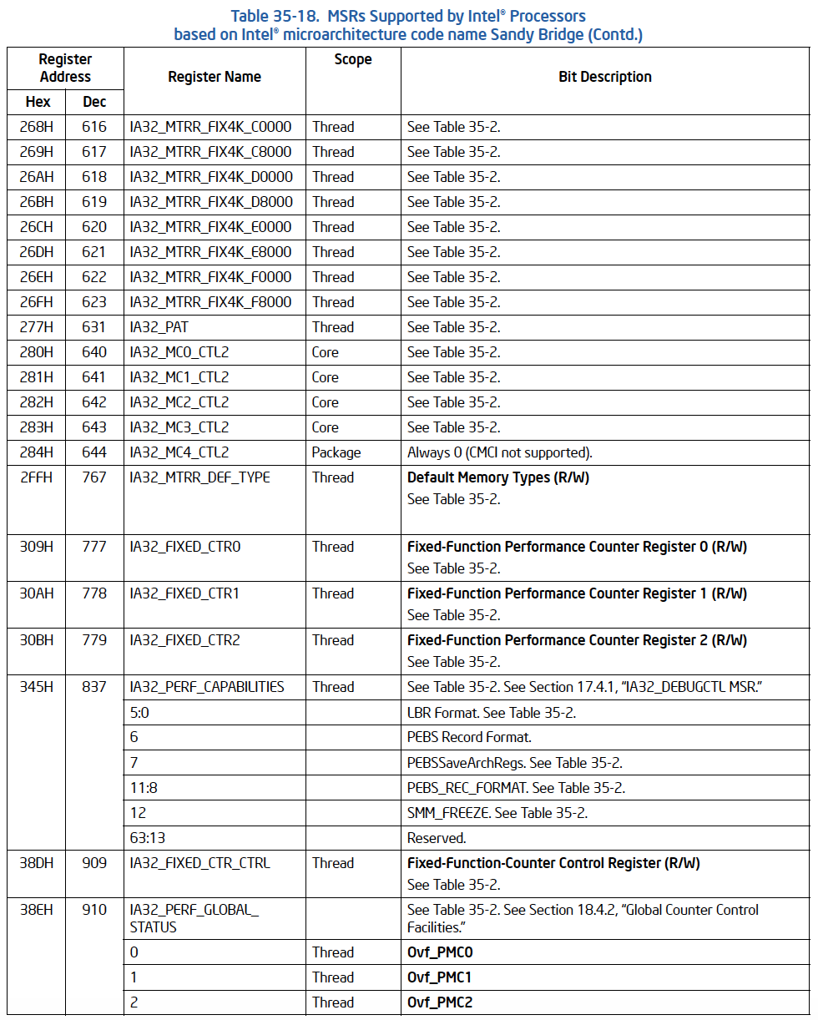
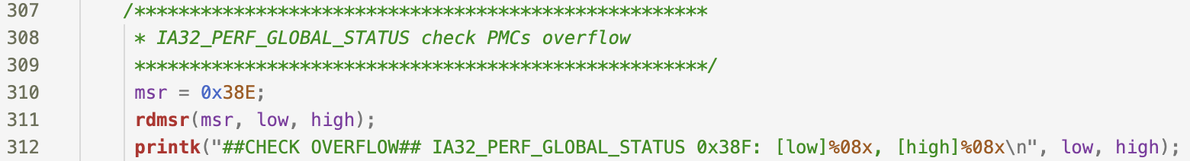
4. Source Code (Cont)
6) Global Status Register (Left: Manual p.649, Right: Manual p.1444)
In case PMCs overflow while counting, check the overflow bit

Slide 20
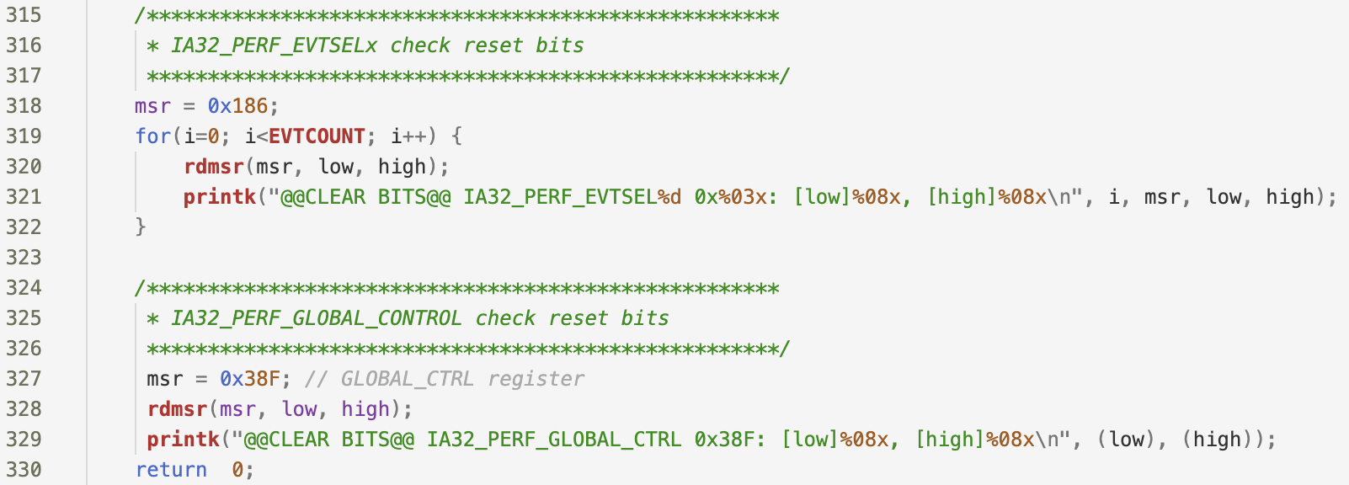
4. Source Code (Cont)
7) EVTSELx and GLOBAL_CTRL registers
Check those two registers are cleared

Slide 21
5. Run The Program In Kernel
1) Before inserting the module, this step must be done:
Command ‘sudo modprobe msr’
This is also a module that allows to use wrmsr and rdmsr instructions
2) Type ‘make’: It will create an insertable module that has ‘.ko’ file format
*Makefile has been attached
3) Type ‘sudo insmod filename.ko’ to insert the module
4) Type ‘sudo rmmod filename’ to remove the module from the kernel
5) Type ‘dmesg’ to check the print statements in the kernel
*To observe the live debugging screen, type ‘dmesg –wH’

